Slide 1
Data Dissemination and Management (2)
Lecture 10

Slide 2
Data Dissemination and Management - Topics
Introduction
Challenges
Data Dissemination
Mobile Data Caching
Mobile Cache Maintenance Schemes
Mobile Web Caching
Summary

Slide 3
The most prevalent use of a mobile computer is for accessing information on remote data servers, such as Web servers and file servers.
Usually, remote data are accessed by sending a request (or a query) to the remote server. In response to the query, the data server sends the requested data.
This access mode is known as pull mode or on-demand mode. However, in pull mode, the mobile node has to explicitly send a query.
This requires competing for wireless access to send the query on the uplink channel and then waiting for the response.
The entire process consumes the mobile node’s precious battery power. Further, wireless bandwidth is consumed—which in some cases may be scarce.
The problem is further exacerbated if multiple users in a wireless cell request the same data.
Another way in which data can be delivered to a mobile node is by pushing the data to it. The data server periodically broadcasts the data (along with some indexing information) on a broadcast (or multicast) channel.
The indexing information is used by a mobile client to determine when the data in which it is interested will be available on the broadcast channel.

Slide 4
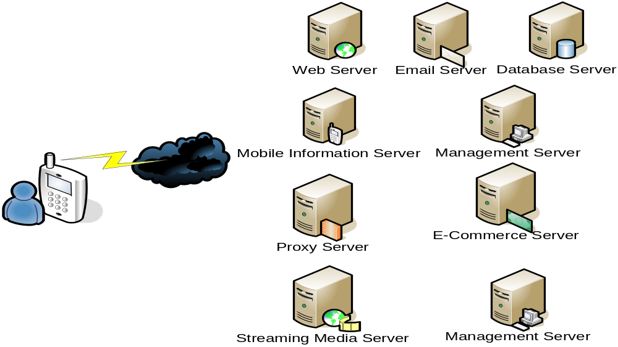
Data Dissemination and Management – Data Dissemination

Slide 5
Data Dissemination
Pull or On-Demand Mode
  Request – through uplink
  Reply – waiting for response
  Consume extra battery power
  Competing bandwidth with other Mobile users
Push or Broadcast Mode
  Data server periodically broadcasts the data
  Indexing information: quick check for interesting or not
  Index, Stock, Traffic, Sales; Index, Stock, Traffic, Sales; …
  Down Load interesting data

Slide 6
Data Dissemination
Advantages of Data Dissemination – Push Mode
  Pull or On-Demand Mode
    Send Hot Data Items
    Conserve bandwidth – eliminates repetitive on-demand data transfers for the same data items to different mobile users
    Conserve the mobile node’s energy – eliminating uplink transmission

Slide 7
Data Dissemination – Wireless Bandwidth Utilization
Logical Channels
A cell’s wireless bandwidth is divided into three logical channels:
  1. Uplink request channel—shared by all the mobile clients to send queries for data to the server
  2. On-demand downlink channel—for the server to send on-demand request data items to the requesting mobile client
  3. Broadcast downlink channel—to periodically broadcast the hottest data items
Physical Channels
  From the implementation perspective, it is convenient to partition the available wireless bandwidth into two physical channels
  On-Demand
    Distributed medium access channels
  Broadcast
    Broadcast schedule
    Slotted data items (pages)

Slide 8
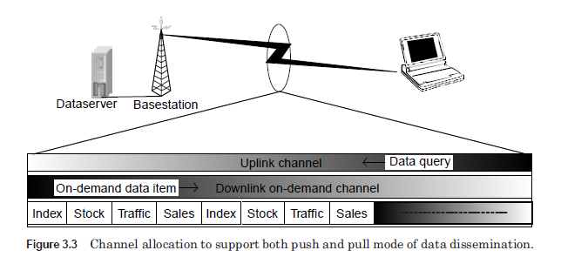
The physical on-demand channel is accessed using a distributed medium access technique such as ALOHA.
Both the uplink request channel and the on-demand channel are mapped to the same physical on-demand channel.
The broadcast channel is slotted such that a data item (page) can fit in each slot.
The data server constructs a broadcast schedule (which page to broadcast when), and the mobile node can tune in at the beginning of the slot in which the data item in which it is interested is going to be broadcast to download that data item.

Slide 9
Data Dissemination - Bandwidth Allocation for publishing
Bandwidth Allocation
  Bandwidth for on-demand channel – B₀
  Bandwidth for broadcast channel – B_{b}
  Available bandwidth B = B₀ + B_{b}
Data Server
  N data items: D1, D2, …, Dn
    D1 – the most popular data items, with popularity ratio P1 (between 0 and 1)
    D2 – the next popular data item with popularity ratio P2 (between 0 and 1)
  Size for each data item – S
  Size of each data query - R
Each mobile node generates requests at an average rate of r

Slide 10
Data Dissemination
Allocate All Bandwidth for On-Demand
Compute Average Access Time T over all data items
  T = Tb + To
  Tb – average access time to access a data item from the broadcast channel
  To – average access time to access an on demand item

Slide 11
Data Dissemination
Allocate All Bandwidth for On-Demand
The Average Time to service an on-demand request
  (S + R)/B₀
If all data items are provided only on-demand, the average rate for all the on-demand items will be
  M x r (queuing generation rate)
  M – the number of mobile nodes in the wireless cell
  r –average request rate of a mobile node

Slide 12
Data Dissemination
Allocate All Bandwidth for On-Demand
Applying Queuing Theory to Analyze the Problem
  As the number of mobile users ↑ (increases),
    -> the average queuing generation rate (M x r) ↑
  As (M x r) approaches → the service rate [B0/(S+R)],
    -> the average service time (including queuing delay) ↑ rapidly
  What is acceptable server time threshold?
  Allocating all the bandwidth to the on-demand channels → Poor Scalability

Slide 13
Data Dissemination
Allocate All Bandwidth for Broadcast Channel
If all the data items are published on the broadcast channel with the same frequency (ignoring the popularity ratio)
Average waiting: n/2 data items
Average access time for a data item:
  (n/2) x (S/B_{b})
  Independent of number of mobile nodes in the cell
  Average access time proportional to the number of data items n
  Average Access Time ↑ as the number of data items to broadcast ↑

Slide 14
Data Dissemination
Bandwidth Allocation – A Simple Case
Two data items: D1 and D2
P1 of D1 > P2 of D2 (D1 is more popular than D2)
  Temp to broadcast D1 all the time → cause D2 access time to be infinite (D2 is never available)
Broadcast frequency calculation to achieve minimum average access time
  F1 = √P1/(√P1 + √P2)
  F2 = √P2/(√P1 + √P2)
  An example: P1 = 0.9, P2 = 0.1
    sqrt(0.9) = 0.9487, sqrt(0.1) = 0.3162
    F1 = 0.75
    F2 = 0.25
    D1 broadcast 3-times more often than D2, even D1 is 9-times more popular than D2

Slide 15
Data Dissemination
Bandwidth Allocation – N Data Items
N data items: D1, D2, …, Dn
Popularity Ratio: P1, P2, …, Pn
Broadcast Frequencies: F1, F2, …, Fn, for achieving minimum latency
  Where fi = √Pi/Q,
  Q = √P1 + √P2 + .. + √Pn
  Minimum latency: P1*t1 + P2*t2 +… + Pn*tn
  t1, t2, …, tn are average access latencies of D1, D2, …, Dn

Slide 16
Data Dissemination
Algorithm by Imielinski and Viswanathan 1994
Publishing modes save the energy of mobile node
  At the cost of increasing access latency
Goal: to put as many hot items on the broadcast channel as possible
  Under the constraint that the average access latency is below a certain threshold L
Algorithm
  What data items to put on the broadcast channel?
  Bandwidth allocation?

Slide 17
Data Dissemination
Algorithm by Imielinski and Viswanathan 1994
Algorithm
For i = N down to 1 do:
Begin
1. Assign D₁, …, D_{i} to the broadcast channel
2. Assign D_{i+1}, …, D_{N} to the on-demand channel
3. Determine the optimal value of B_{b} and B_{o}, to minimize the access time T, as follows
a. Compute T_{o} by modeling on-demand channel as M/M/1 (or M/D/1) queue
b. Compute T_{b} by using the optimal broadcast frequencies F₁, …, F_{i}
c. Compute optimal value of B_{b} which minimizes the function T = T_{o} + T_{b}.
4. if T <= L then break
End

Slide 18
Data Dissemination
Broadcast Disk Scheduling
The Task
  Decide which data items to publish
  Determine how often to publish a data item
Logical View of Broadcast Channel
  A memory disk in the air: an extension to the memory hierarchy of the mobile device
Physical Structure
  Multiple virtual disks, spinning at different rated
  Fastest-spinning disk: hottest data item
  Next-fast disk: next hottest data item

Slide 19
Data Dissemination
Broadcast Disk Scheduling
An Example (Figure 3-5)
9 Data items:
  D1, D2, …, D9
3 Disks
  Disk 1: D1
  Disk 2: D2, D3, D4, D5
  Disk 3: D6, D7, D8, D9
Frequency of Broadcast
  Items on Disk 1 appear 4-times as frequently as those on disk 3
  Items on Disk 2 appear 2-times as frequently as those on disk 3
Speed of Spinning
  Disk 1 – Fastest
  Disk 2 - Middle
  Disk 3 - Slowest

Slide 20
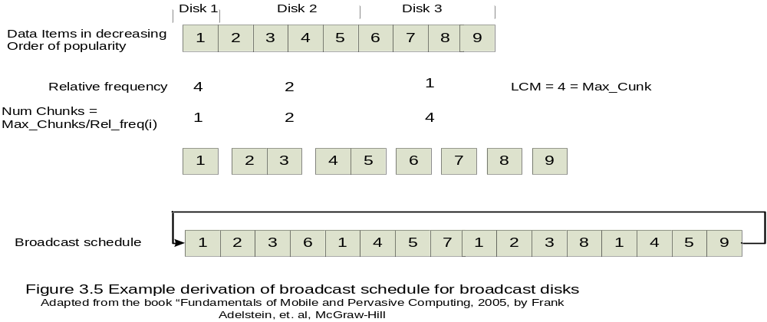
Data Dissemination
Broadcast Disk Scheduling

Slide 21
Data Dissemination
Broadcast Disk Scheduling – AAFZ Algorithm
Developed by Acharaya, Alonso, Franklin, and Zodnik
Scheduling of Broadcast Channel that achieves a selected relative spinning of the disk
Inputs
  Number of disks
  The assignment of data items to the disk
  Relative spinning frequencies of the disks
Output
  Broadcast schedule
An Example – Figure 3-5
  Rel_freq(disk_1) = 4
  Rel_freq(disk_2) = 2
  Rel_freq(disk_3) = 1

Slide 22
Data Dissemination
Broadcast Disk Scheduling – AAFZ Algorithm
Order the data items from the hottest to coldest
Partition the list into multiple ranges, called disks. Each disk consists of data items which nearly same popularity ratio. Let the number of disks chosen be num_disks.
Choose the relative frequency of broadcast for each disk
Cluster the items in each disk into smaller units called chunks;
number_chunk(i) = max_chunks/rel_freq(i),
  where max_chunks is the least common multiple of relative frequencies

Slide 23
Data Dissemination
Broadcast Disk Scheduling – AAFZ Algorithm
Create broadcast schedule as follows: (see references)
  For i = 0 to max_chunks -1
    For j = 1 to num_disks
      K = i mod num_chunks(j)
      Broadcast chunk Cj,k
    End_for
  End_for

